Slide 1

MINI PROJECT USING CONCEPTS OF
DATA STRUCTURES AND ALGORITHMS
ANALYSIS ON CANDIDATE JOB RECRUITMENT
TEAM MEMBERS:
SRUTHI R, YAZHINI KARTHIK, SHWETHAMBARI V

Slide 2
DATA STRUCTURES AND ALGORITHMS CONCEPTS USED:
ARRAYS
SORTING
DECISION TREE
These concepts are also implemented ,refered and compared with a few of the probability concepts

Slide 3
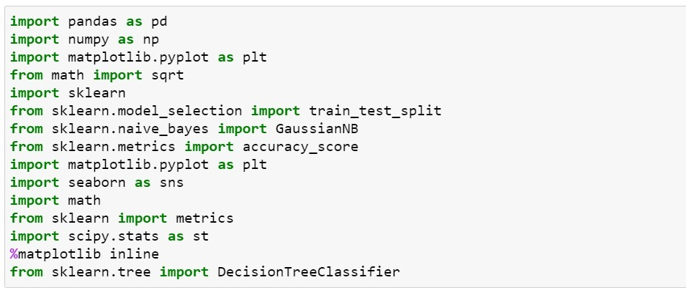
LIBRARIES USED:

Slide 4
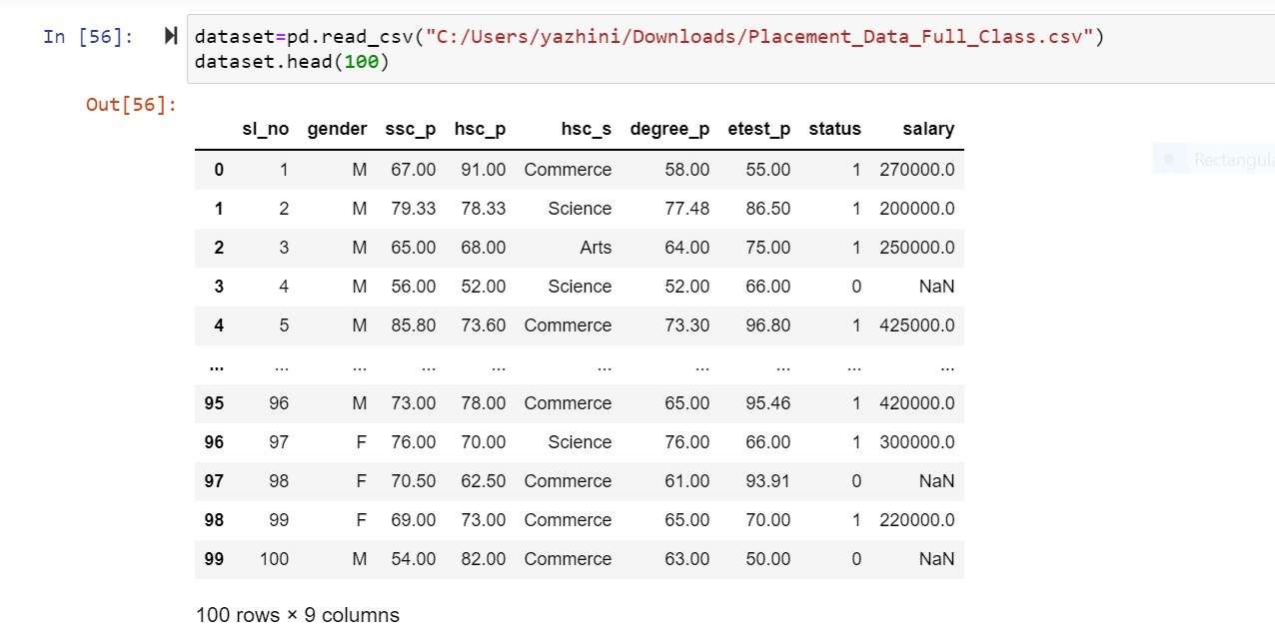
IMPORTING THE DATASET ( CSV FILE ):

Slide 5

SORTING:
Sorting refers to ordering data in an increasing or decreasing fashion according to some linear relationship among the data items. This is done so that we can analyze data more effectively.

Slide 6
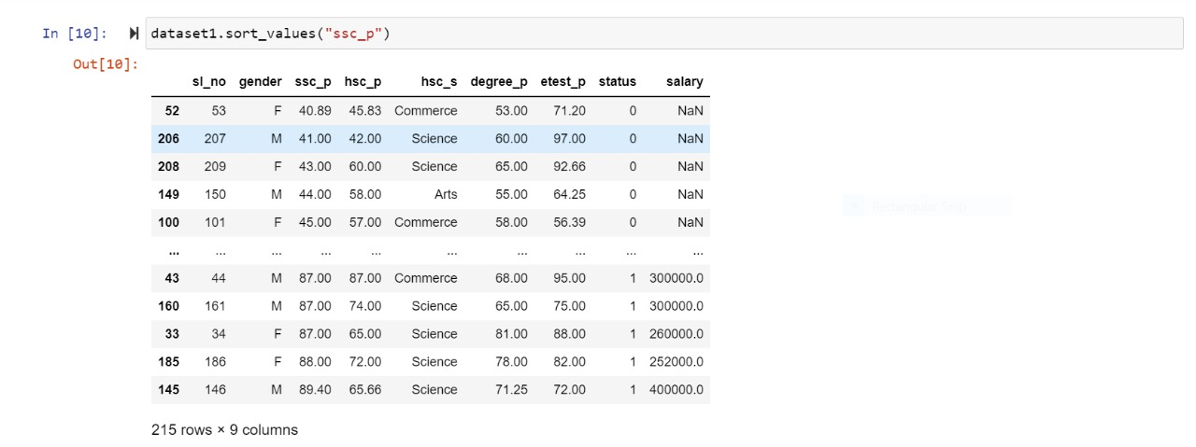
Sorting a column from the dataset:

Slide 7
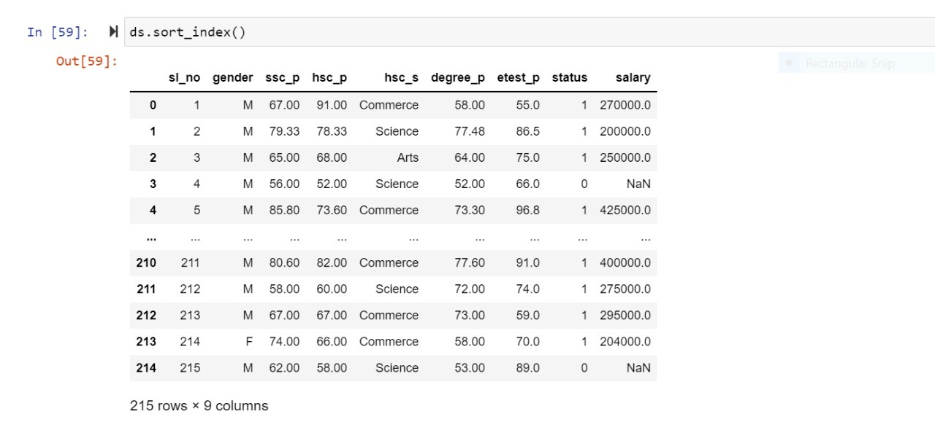
Once when a column is sorted ,the index values get changed. So using .sort_index( ) function,we can sort also the index values .

Slide 8
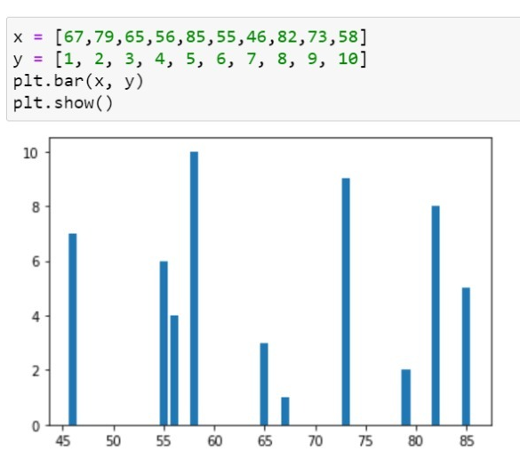
B
A
R
G
R
A
P
H
Comparing the unsorted data members with the sorted members by graphical representation:

Slide 9
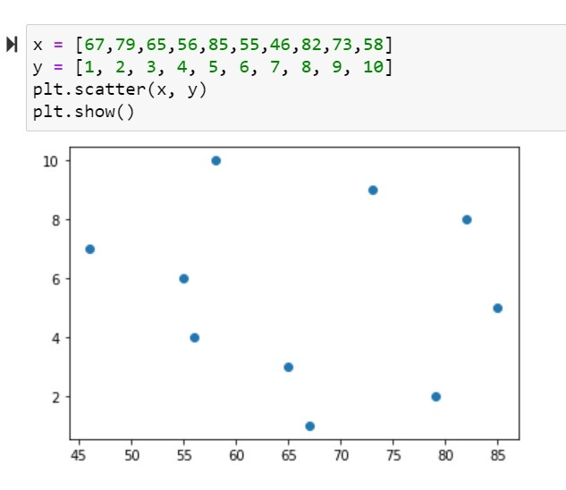
S
C
A
T
T
E
R
P
L
O
T

Slide 10
The previous picture symbolizes the bar and scatter graphs of ssc_p column without getting sorted. Take a look on the varying proportion of the values in the graph.
That is because the values are not sorted.
Now, we’ll have a look on the graphs from a sorted column (ssc_p).

Slide 11
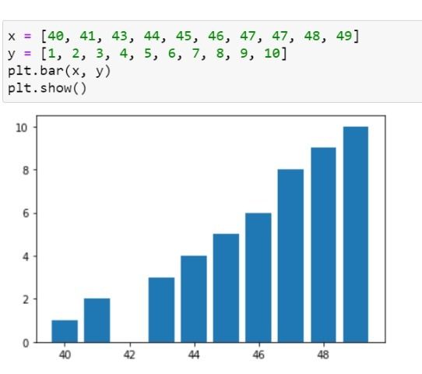
B
A
R
G
R
A
P
H

Slide 12
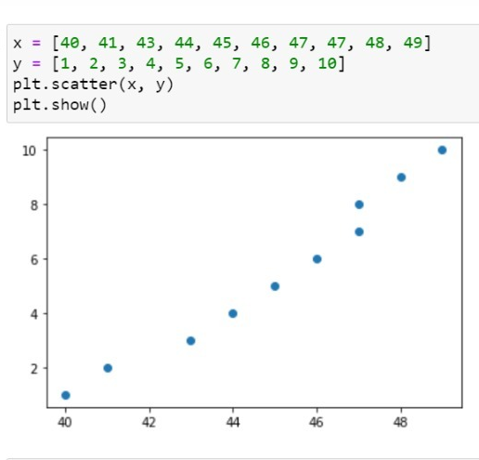
S
C
A
T
T
E
R
P
L
O
T

Slide 13
We Can also use unsorted graph for interpretation ,but the more organized way is approached in a sorted graph.So when sorting is used, the graph becomes more clear and understandable.

Slide 14

ARRAYS:
Array is the simplest data structure where each data element can be randomly accessed by using its index number.
ARRAYS:
Array is the simplest data structure where each data element can be randomly accessed by using its index number.

Slide 15
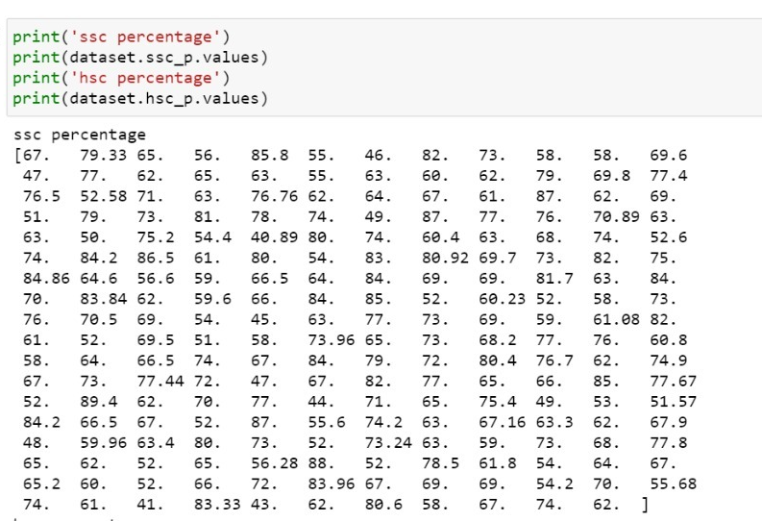
Printing arrays for two columns- ssc % and hsc %:

Slide 16
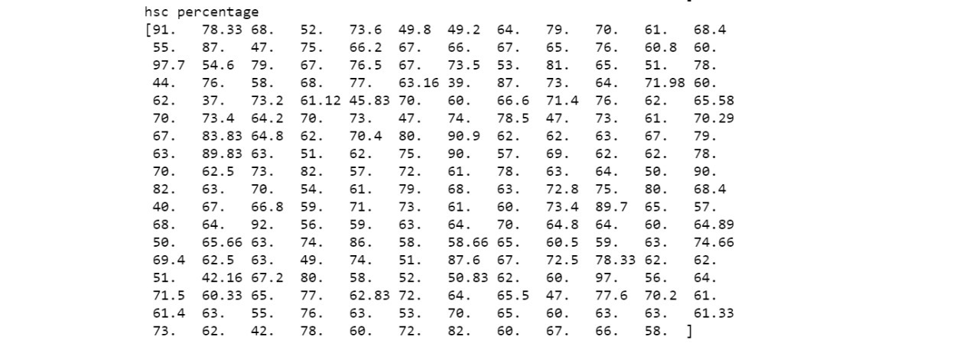

Slide 17
In one of the probability concepts- Univariate analysis,
arrays can be used:
“Uni” means one and “Variate” means variable hence univariate analysis means analysis of one variable or one feature. Univariate analysis basically used to tells us how data in each feature is distributed.
Here , Salary is taken as the variable and univariate analysis is Processed.

Slide 18
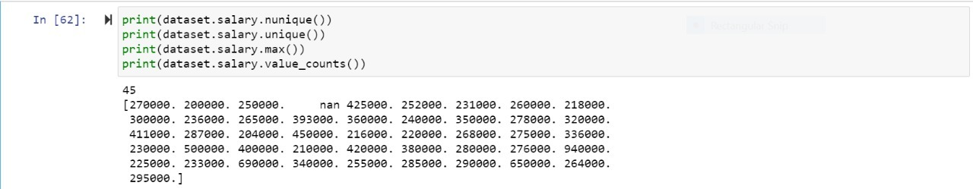
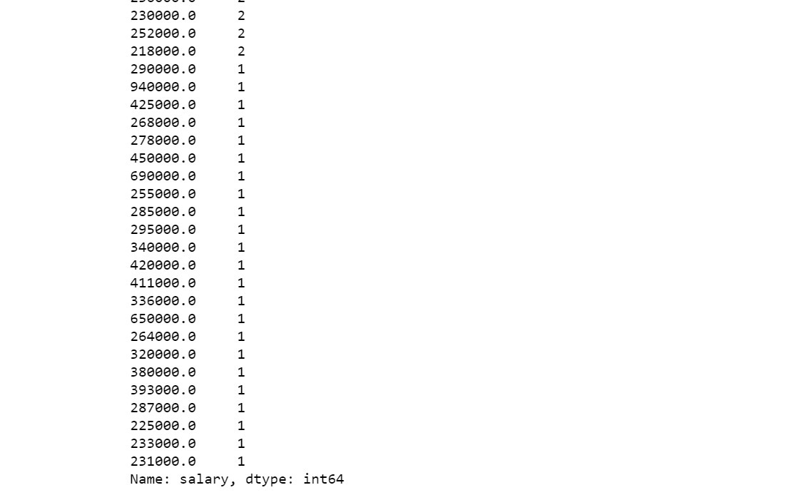

Slide 19

DECISION TREE:
A decision tree is a very specific type of probability tree that enables you to make a decision about some kind of process. For example, you might want to choose between manufacturing item A or item B, or investing in choice 1, choice 2, or choice 3.
Here, the accuracy is checked using normal train test method and compared with the accuracy of the decision tree method.

Slide 20
NAÏVE BAYES THEOREM:
Naïve implies that every pair of features in the dataset is independent of each other.
The bayes thorem describes the probability of a feature based on prior knowledge of situations related to that feature.

Slide 21
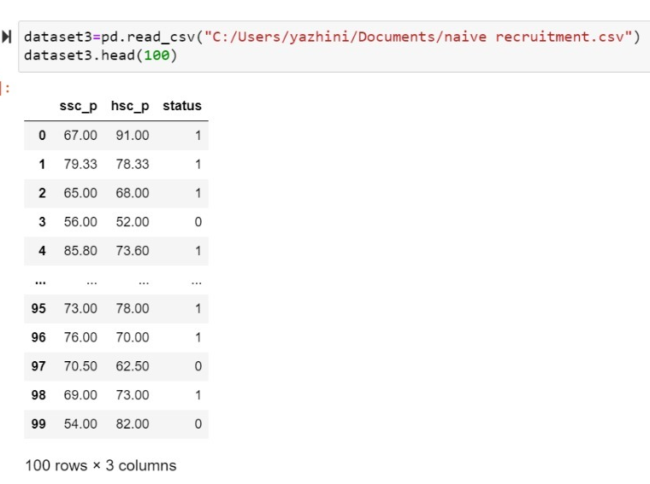
NEW DATASET DECLARATION:

Slide 22
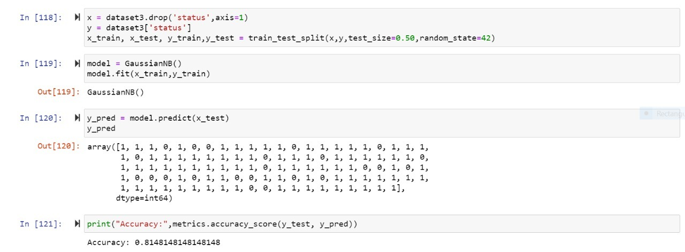
1.DATA PRE-PROCESSING:
We’ll create the x and y variables from dataset using train_split_test function then split the data into train and test sets (subsets).
There is no need to divide the dataset manually.
For the output of train_test_split, we get x_train,x_test and y_train,y_test.

Slide 23
2.TRAIN THE MODEL:
Tuning the models to match their requirements.

Slide 24
3.PREDICTION:
Once the model is trained it is ready to make predictions.We can use the predict method on the model and pass x_test as a parameter to get the output as y_pred.
Prediction output is an array of real numbers corresponding to the input array.

Slide 25
4.MODEL EVALUATION:
We evaluate our model by finding the accuracy
score produced by the model.

Slide 26
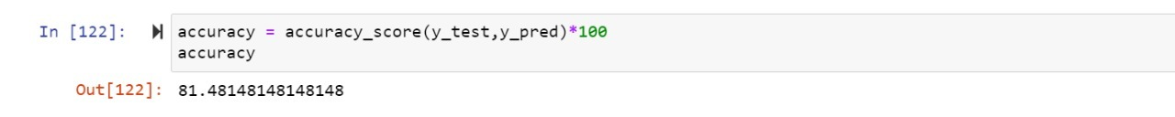
4.PERCENTAGE:
We’ll find the percentage value of the accuracy
produced by the model.

Slide 27

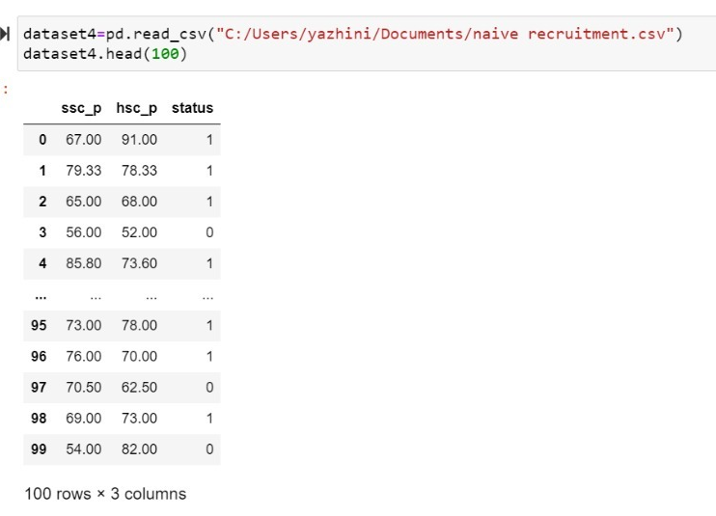
NEW DATASET DECLARATION:

Slide 28
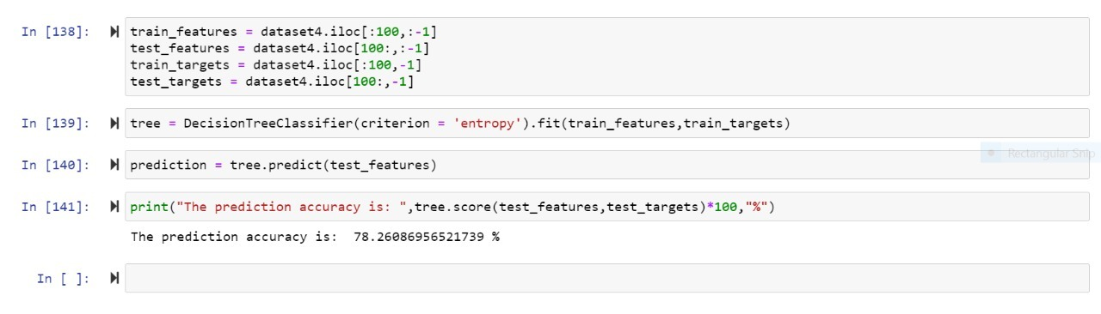
Similar to train and test sets,train and test features and targets are created in the implementation of decision trees.

Slide 29
Prediction and finding accuracy are done with the code related to decision tree:

Slide 30
The data pre-processing and train tests can be done using normal methods for naïve bayes classification ,but here on the context that decision tree is a data structure involved in naïve bayes theorem which gives the result approximately similar to the normal method.

Slide 31
The data pre-processing and train tests can be done using normal methods for naïve bayes classification ,but here on the context that decision tree is a data structure involved in naïve bayes theorem which gives the result approximately similar to the normal method.

Slide 32
THANK YOU!!!

